Slide 1
Cost-Aware Predictive Resource Orchestration for Distributed Cloud Workloads
M.TECH CLOUD COMPUTING
Using workload forecasting to scale a worker pool: a simulation prototype and first results
Presented by
Supervisor
Institute
Aman Kumar PA2507MTE08
Sunil Chauhan, Technical Engineering Manager & Architect Netcracker Technology
IIT Patna · November 2026
Notes:
Introduce yourself and the project. One sentence: this project asks whether forecasting the workload and being aware of how the cloud bills can scale a worker pool more cheaply without hurting latency. Say up front that everything shown today comes from a simulation prototype, not a real cloud deployment.

Slide 2
Every scaling decision trades cost against latency
THE PROBLEM
Cold starts
Billing blocks
Tail latency
A new worker needs tens of seconds to minutes before it can take work. Reactive scaling is always one interval plus one cold start late.
Providers charge in blocks. Releasing a worker early in a paid block saves nothing; relaunching it starts a new block.
Users feel the slowest requests. The 95th-percentile latency matters more than the average.
Question: at each control interval, how many workers should run so that simulated cost is low and queue wait and p95 latency stay low, using only data available at decision time?
Cost-Aware Predictive Resource Orchestration · Progress presentation
Notes:
Three forces make autoscaling hard. Cold starts mean new capacity arrives late. Billing granularity means releasing and relaunching can cost more than keeping a worker. And users experience tail latency, so we measure p95, not just the mean. The research question: can forecasting the workload, and making scale-in billing-aware, give a better cost/latency trade-off than fixed or reactive scaling?

Slide 3
The prototype is built; validation is still ahead
OBJECTIVES AND PROGRESS
# | Objective | Status
O1 | Reproducible simulation framework for a configurable worker pool | Done (prototype)
O2 | Module A: evaluate moving-average workload forecasters | Done (prototype)
O3 | Module B: fixed, reactive, predictive and cost-aware scaling | Done (prototype)
O4 | Metrics (wait, p95, throughput, worker-hours, cost, forecast error) and CSV export | Done
O5 | Maven build on a networked machine | Pending
O6 | Validation on real traces or a real cluster | Not started
Cost-Aware Predictive Resource Orchestration · Progress presentation
Notes:
Summarise progress honestly. The framework and both modules work as a prototype, with 66 tests passing and reproducible CSV output. Two things are not done: running the official Maven build (the development sandbox blocked Maven Central) and any validation outside the simulator.

Slide 4
One shared framework, two independent modules
ARCHITECTURE
Module A · Forecasting
Module B · Orchestration
Walk-forward evaluation: MAE, RMSE, MAPE
Fixed, Reactive, Predictive, Predictive-CA
Shared task execution framework
Execution
Workload
Forecast
Cost
Metrics
event engine, worker pool, policy API
synthetic generator, trace replay
NAIVE, SMA, WMA, EMA
billing blocks, minimum time
p95, SLA, worker-hours
Java 17 · Maven · no runtime dependencies · 3,076 lines of code, 1,075 lines of tests · modules never import each other (enforced by a test)
Cost-Aware Predictive Resource Orchestration · Progress presentation
Notes:
The framework holds everything both modules need: a discrete-event engine with a worker pool and a scaling-policy interface, a workload generator, forecasters, a cost model, and metrics. The two research modules sit on top and are independently runnable from one jar. A test checks that the framework never imports a module and the modules never import each other. Spring Boot was considered but not used: this is an offline batch simulator.

Slide 5

A deterministic discrete-event simulator
SIMULATION MODEL
Workload
FIFO queue
Worker pool
Metrics
Poisson arrivals: daily cycle + random bursts
tasks wait for a free worker
one task per worker, log-normal service
wait, p95, cost, worker-hours
Every 60 s the scaling policy sees only monitoring data
arrivals and completions in the last interval · queue length · ready, busy and starting workers · utilization · observed mean service time. It returns a target pool size; new workers become ready after the cold-start delay.
Reproducible: simulated time, seeded random streams; re-runs give identical CSVs.
Fair: within a seed every policy replays the same tasks (common random numbers).
Cost-Aware Predictive Resource Orchestration · Progress presentation
Notes:
Explain the event loop: arrivals, completions, worker-ready events and control ticks, processed in time order. The policy never sees future arrivals. Two properties matter for research: runs are exactly reproducible, and all policies are compared on the identical task list for each seed, so differences come from the policies. The engine is tested against hand-computed cases and against exact conservation laws such as total queue time equals total waiting time.

Slide 6
Four ways to size the worker pool
MODULE B · SCALING POLICIES
Fixed-n
Reactive
Always n workers. Fixed-12 is sized near mean load, Fixed-32 near the burst peak.
+4 workers if utilization ≥ 0.80 or ≥ 2 queued per worker; −2 if utilization ≤ 0.40 and queue empty; cooldowns.
Predictive
Predictive-CA (cost-aware)
Forecast next interval’s arrivals with SMA(3), then size the pool with Little’s law plus a backlog term.
Same sizing, but a removed worker keeps serving until its paid billing block ends, unless scale-out reclaims it.
workers = ceil( rate_forecast × S / 0.75 × 1.10 + queue × S / interval )
Cost-Aware Predictive Resource Orchestration · Progress presentation
Notes:
Fixed allocation gives the two extremes of the trade-off. Reactive is a classic threshold rule with cooldowns. Predictive forecasts the arrival rate lambda-hat, multiplies by the observed mean service time S to get the offered load in busy workers (Little’s law), divides by a target utilization of 0.75 and adds a 10 % safety margin, plus extra workers to clear any backlog within one interval. The cost-aware variant changes only scale-in: it does not throw away paid time.

Slide 7
Four configurations, five seeds each
EXPERIMENTAL SETUP
Configuration | Workload | Pool and timing | Billing
Forecast (Module A) | 24 h, 4 tasks/s base, daily cycle ±60 %, ~1 burst/h | 5-min intervals, horizons 1 and 3 | –
Default (Module B) | 2 h, 4 tasks/s base, 1-h cycle ±60 %, 2 bursts/h ×2.5 | 1–40 workers, 60 s cold start | per minute
Hourly billing | same as default | same as default | per hour
Slow cold start | as default, 4 bursts/h | 180 s cold start | per minute
Seeds 42–46. Results are mean ± sample standard deviation over seeds. Service time is log-normal, mean 2 s. Prices are abstract units (0.10 per worker-hour). SLA threshold: 10 s latency. Each full run takes about 1 s.
Cost-Aware Predictive Resource Orchestration · Progress presentation
Notes:
All four configurations ship with the code. The workload parameters are illustrative choices, not fitted to a real system. Module B compresses a daily cycle into one hour so the two-hour run sees two full cycles. Five seeds is enough to see patterns but not enough for statistical claims; that is on the plan.

Slide 8
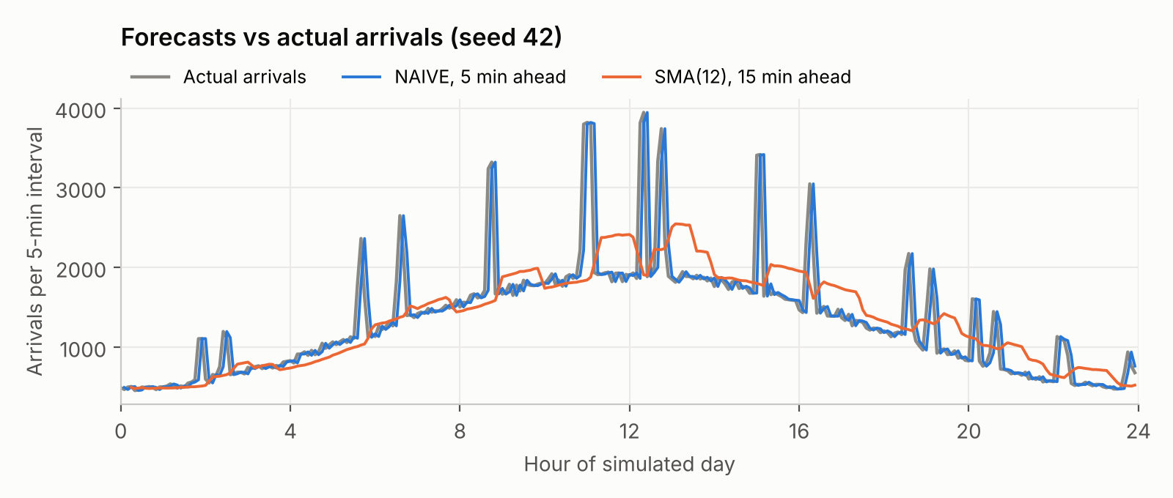
Moving averages follow the trend but miss every burst
MODULE A · FORECASTING RESULTS
NAIVE copies each burst one interval late.
SMA(12) smooths bursts into a broad hump that arrives after the burst has ended.
No moving average can anticipate the start of a burst.
Seed 42 · one simulated day · 288 five-minute intervals · walk-forward (no look-ahead)
Notes:
This is one simulated day. The grey line is the actual arrivals; the daily cycle is clear, and the spikes are random bursts. The blue line, NAIVE one step ahead, is just the grey line shifted by one interval. The orange line, a 12-interval moving average predicting three steps ahead, follows the daily trend well but turns bursts into late humps. Evaluation is walk-forward: every forecast uses only past intervals.

Slide 9
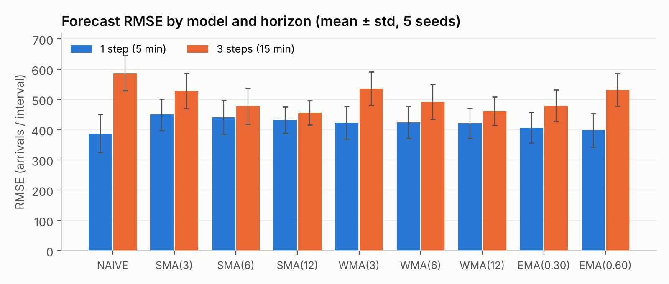
The best window depends on how far ahead you look
MODULE A · FORECASTING RESULTS
5 min ahead · lowest RMSE
NAIVE · 387
15 min ahead · lowest RMSE
SMA(12) · 457
Bursts last about two intervals, so the last value wins short-term; longer windows win further out, where NAIVE is worst (588).
RMSE in arrivals per 5-min interval (mean level ≈ 1,350) · mean ± std over 5 seeds · 274 scored intervals per seed
Notes:
Across five seeds, at one step ahead the naive forecast had the lowest RMSE because a burst usually lasts two intervals. At three steps the ranking flips: the 12-interval SMA and WMA are best and naive is worst. The error bars overlap for many models, so I treat the ranking as indicative only. The practical lesson for Module B: the forecast horizon must match the cold-start delay.

Slide 10
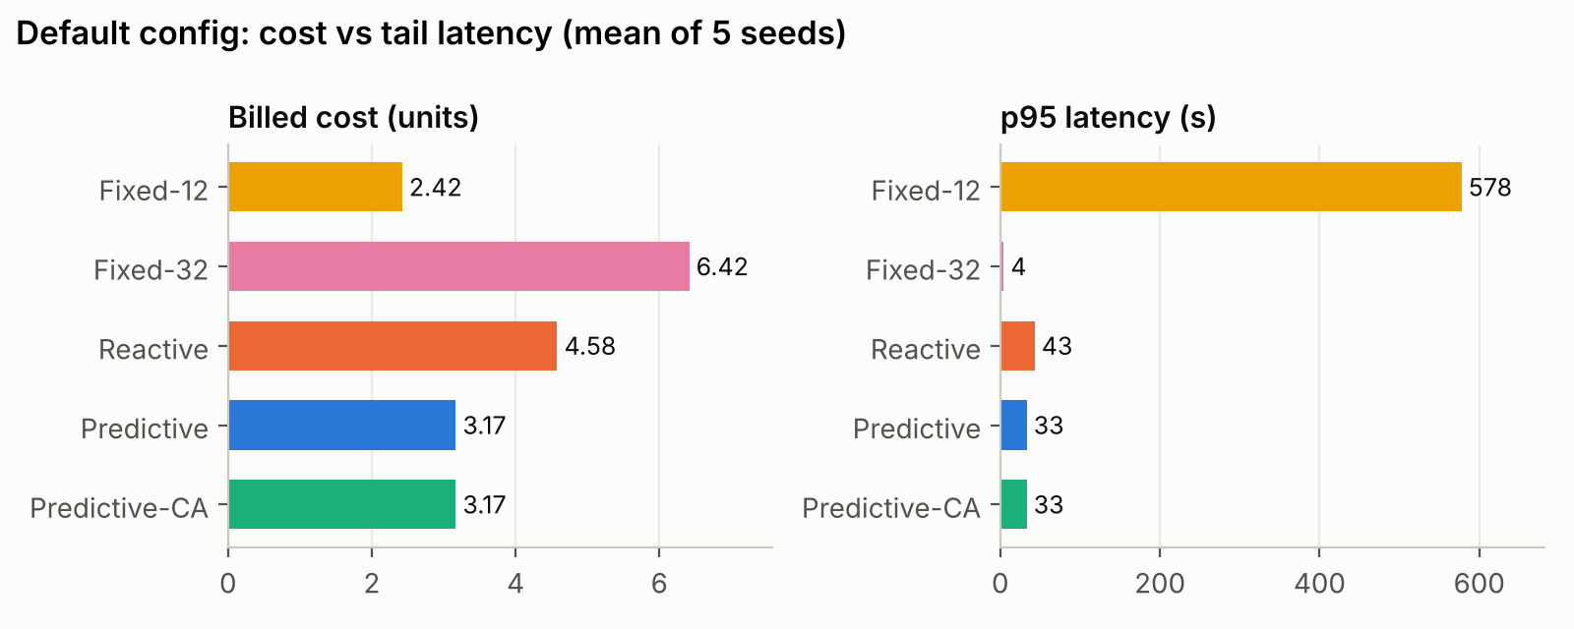
Adaptive policies sit between the extremes
MODULE B · DEFAULT CONFIGURATION
Predictive vs Reactive: 31.5 vs 45.6 worker-hours and p95 33 s vs 43 s, but SLA violations 18.7 % vs 13.2 %.
Predictive-CA = Predictive here: with per-minute billing every billing boundary falls on a control tick.
Mean of 5 seeds · per-minute billing · 60 s cold start · no significance test yet
Notes:
Fixed-12 is cheapest but its queue explodes during peaks: p95 of 578 seconds. Fixed-32 almost never queues but costs 2.6 times as much and sits at 31 % utilization. Predictive used about 31 % fewer worker-hours than reactive with a lower mean p95, but a higher SLA-violation rate, so neither wins every metric. The cost-aware variant is identical here because with per-minute billing nothing is ever deferred.

Slide 11
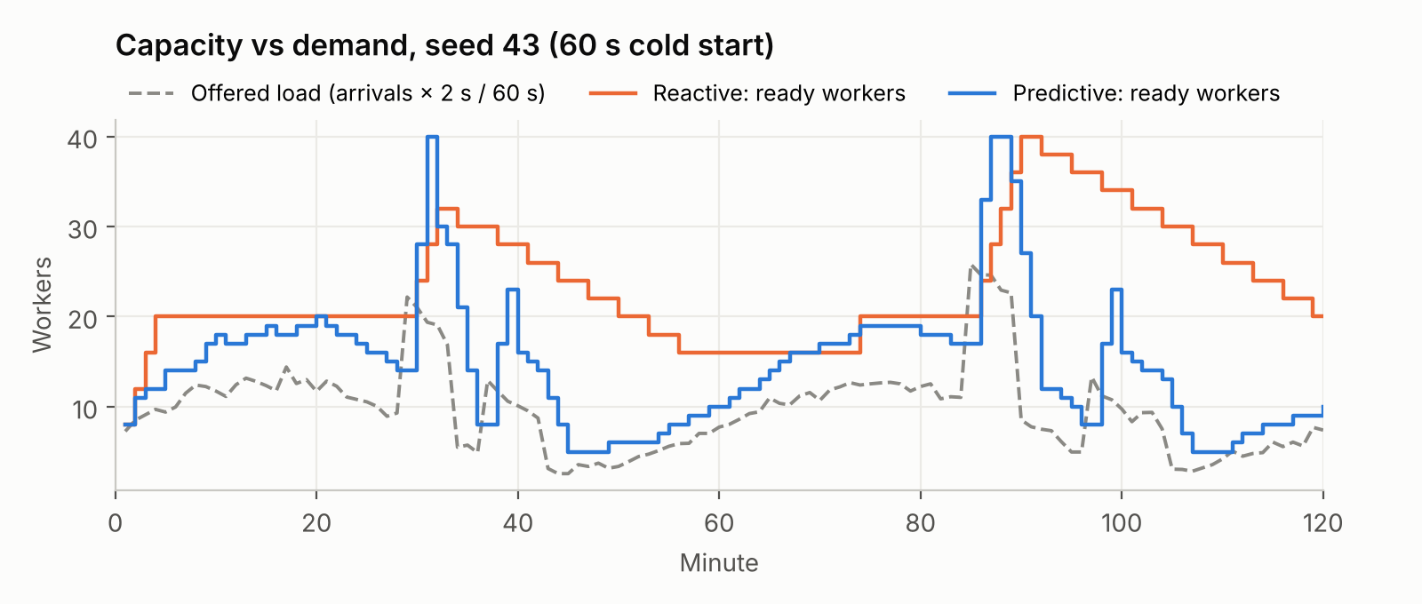
Predictive follows demand; reactive holds surplus
MODULE B · INSIDE ONE RUN
Reactive steps down 2 workers every 3 minutes, so capacity lingers long after each peak.
Predictive tracks the load closely, but reacts to bursts only after they start.
On this seed reactive still had the lower p95 (22 s vs 36 s).
Seed 43 · offered load = arrivals per minute × 2 s mean service ÷ 60 s · from orchestration_intervals_seed43.csv
Notes:
This plot comes straight from the per-interval CSV the simulator writes. The dashed line is the offered load in busy workers. Reactive climbs in steps and then scales in slowly because of its cooldown, so it holds surplus capacity for half an hour after each peak. Predictive hugs the load, which is why it is cheaper, but it is also why it can be caught short at the start of a burst. On this particular seed reactive actually had better tail latency, which is a good reminder that one seed proves nothing.

Slide 12
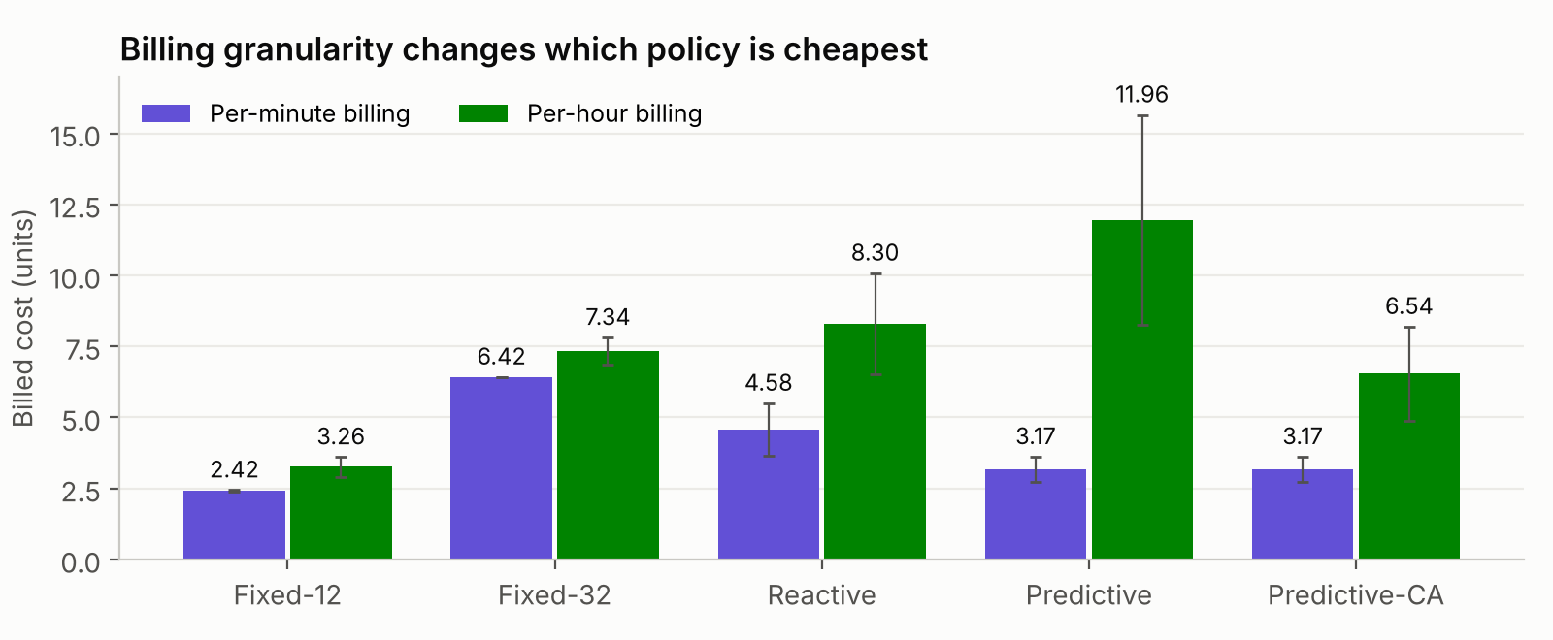
With hourly billing, cost-aware scale-in pays off
MODULE B · BILLING GRANULARITY
Hourly billing, Predictive-CA vs Predictive
−45 %
cost (11.96 → 6.54), and p95 latency fell from 33 s to 20 s.
Plain Predictive was the most expensive policy: each scale-in then scale-out buys a new hour.
Same workloads as the default run · mean ± std over 5 seeds · prices in abstract units
Notes:
This is the clearest result so far. With per-minute billing the cost-aware variant changes nothing. With hourly billing, the plain predictive policy becomes the most expensive of all, because it scales in and out often and every relaunch starts a new paid hour. Keeping workers until their paid hour ends cut cost by about 45 % and also improved tail latency, because those already-paid workers keep serving. The mechanism matters exactly when billing is coarse.

Slide 13
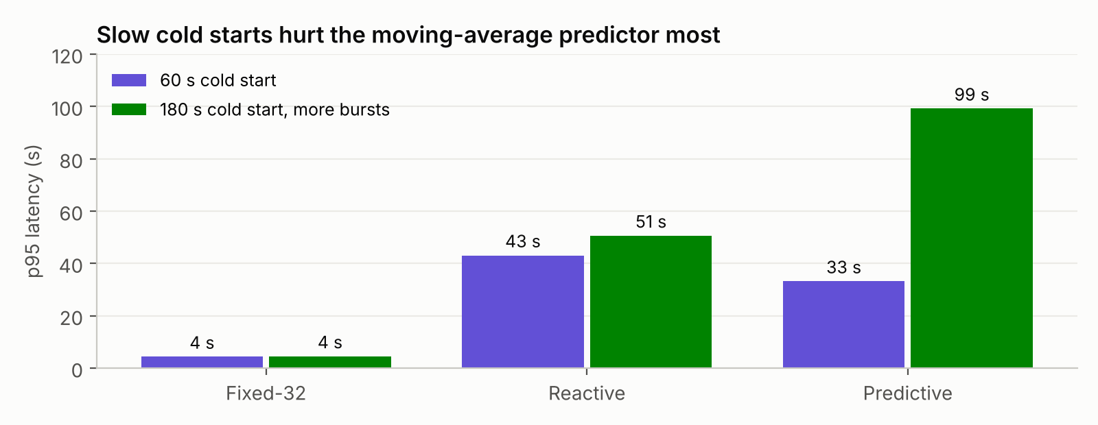
Slow cold starts expose the forecaster’s limit
A NEGATIVE RESULT
With 180 s cold starts, Predictive’s p95 rose to 99 s, about twice Reactive’s 51 s.
A flat moving average cannot see a ramp three intervals ahead, so capacity arrives after the burst.
Next: trend-aware forecasting.
180 s configuration also has 4 bursts/h instead of 2 · mean of 5 seeds · parameters not tuned
Notes:
I kept this result in deliberately. When cold starts take three minutes, the predictive policy is worse than reactive. The reason is the forecaster: a moving average is flat, so it cannot anticipate a ramp three intervals ahead. That points the next phase at the forecaster rather than the orchestration mechanism. Note that this configuration also has more bursts, so it is not a single-variable comparison.

Slide 14
What has been checked, and what has not
VERIFICATION STATUS
Check | Result
Compiles with javac --release 17, all warnings as errors | Pass
66 unit and integration tests (hand-computed cases, conservation laws) | 66 pass, 0 fail*
Re-running an experiment gives byte-identical CSV files | Pass
mvn clean verify | Not yet run
Comparison with a real cloud or real traces | Not yet done
* The development sandbox blocked Maven Central, so the JUnit 5 tests ran against a small local stand-in for the JUnit API. The official Maven build is the first task of the next phase.
Cost-Aware Predictive Resource Orchestration · Progress presentation
Notes:
Be precise here. The code compiles cleanly and all 66 tests pass, but they were run without Maven because the sandbox could not download from Maven Central; a stand-in for the JUnit API was used and checked to report failures. Running mvn clean verify on a normal machine is the first next step. Nothing has been validated outside the simulator.

Slide 15
Read every number as a simulation result
ASSUMPTIONS AND LIMITATIONS
Simulated only
Synthetic load
Small samples
No real-cloud validation; seconds and cost units mean nothing outside the model.
Parameters are illustrative, not fitted. Trace replay exists but is untested on real data.
Five seeds, mean and std only; no confidence intervals or tests yet.
Simple model
Untuned policies
Prototype
Identical workers, one FIFO queue, no failures, perfect monitoring.
Thresholds, cooldowns and windows were set once, not optimised.
Research code; not production-ready or security-reviewed.
Cost-Aware Predictive Resource Orchestration · Progress presentation
Notes:
State the limits before the examiners do. The comparisons are only meaningful inside the model and under its assumptions. The sample is small, the policy parameters were not tuned, and the workload is synthetic. These limits shape the plan on the next slide.

Slide 16
From prototype to defensible results
PLAN FOR THE REMAINING WORK (PROPOSED)
1
Run mvn clean verify on a networked machine; add CI
2
Trend- and seasonality-aware forecasters (Holt, Holt-Winters); re-test slow cold starts
3
Cost-aware sizing: an explicit cost + SLA objective in the predictive policy
4
Replay aggregated public cluster traces through both modules
5
Parameter sweeps with 20–30 seeds, confidence intervals and paired tests
6
Thesis writing and final evaluation
Cost-Aware Predictive Resource Orchestration · Progress presentation
Notes:
The plan follows directly from the limitations. First, an authoritative build. Second, the forecaster, because the slow-cold-start result showed it is the bottleneck. Third, make the predictive policy explicitly trade cost against SLA. Fourth and fifth, realistic traces and proper statistics. Then the thesis. An optional small check on local containers could also test the simulator’s assumptions.

Slide 17
Thank you. Questions?
Forecasting cut worker-hours in simulation; billing-aware scale-in mattered under coarse billing; slow cold starts need a better forecaster.
LIVE DEMO
mvn clean verify
java -jar target/cloud-orchestration-sim-0.1.0-SNAPSHOT.jar forecast configs/forecast-default.properties
java -jar target/cloud-orchestration-sim-0.1.0-SNAPSHOT.jar orchestrate configs/orchestration-default.properties
Notes:
Close with the three takeaways, then offer a live demo if time allows: build and test with Maven, run Module A, run Module B, and optionally run the hourly-billing configuration to show the cost-aware effect. Re-running any command gives identical CSV output, which demonstrates reproducibility.

